Slide 1
Data Transformation and the Grammar of Graphics

Slide 2
The Data Science Pipeline

Slide 3
Nouns, Verbs, and Sentences
Noun: a dataframe
Verb:
filter(): Pick observations by their values.
arrange(): Reorder the rows.
select(): Pick variable by their names.
mutate(): Create new variables with functions of existing variables.
summarize(): Collapse many values down to ta single summary.
Example: From the mpg data frame, filter out all but the compact cars and select only the city mpg variable and put the result in a data frame called compactCarsMPG.
compactCarsMPG = mpg %>% <filter all but compact cars> %>% <select only the city mpg variable>

Slide 5
Filtering | filter()

Slide 6
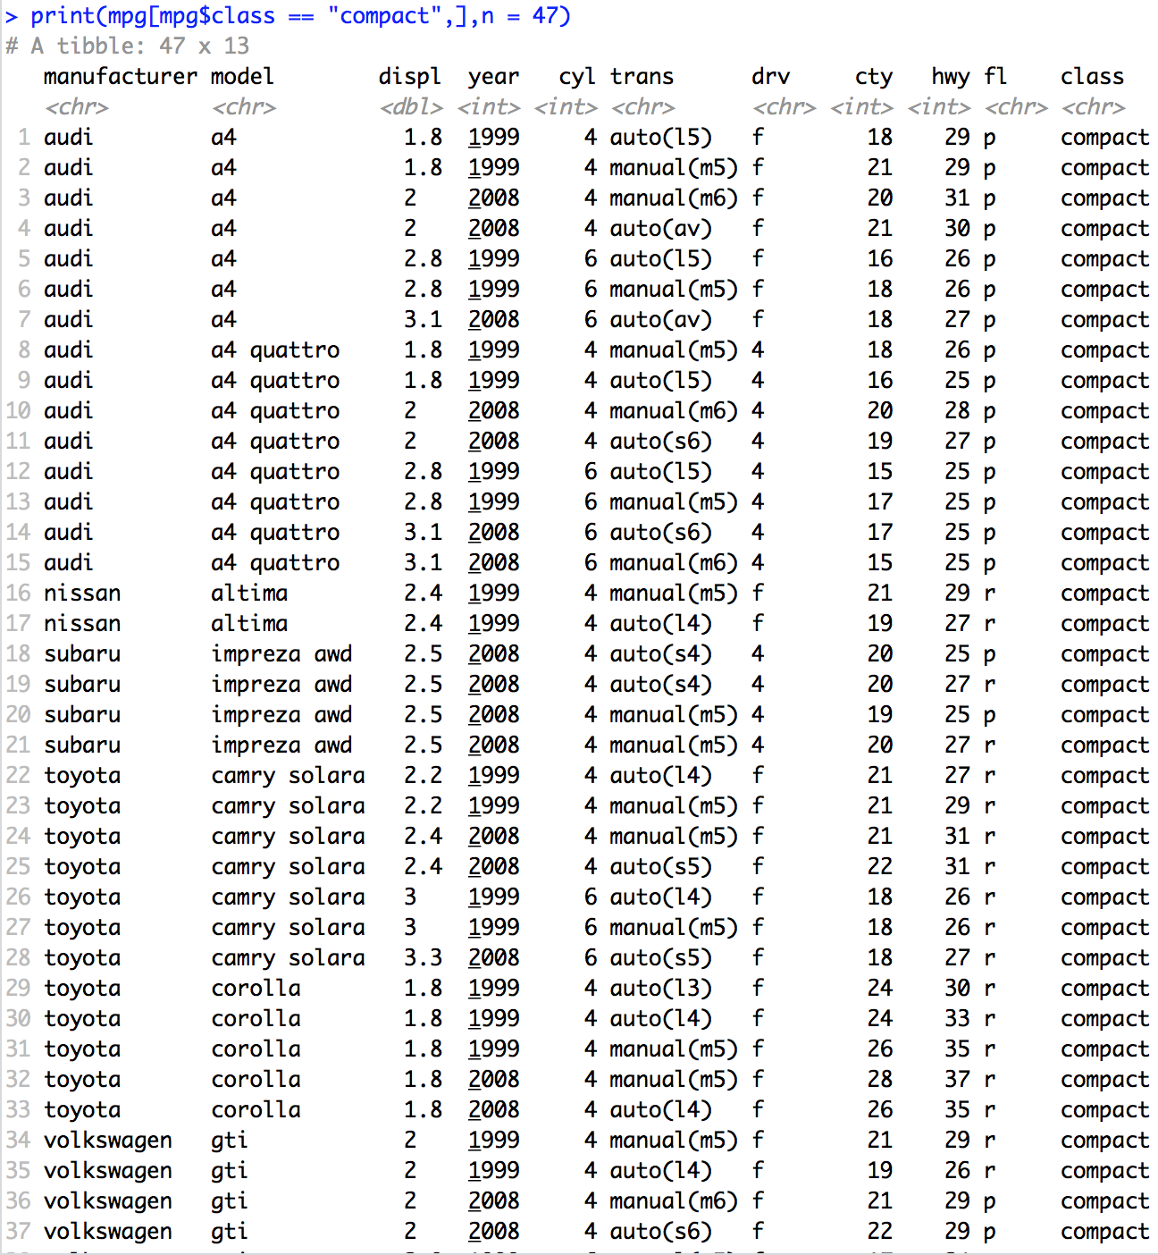
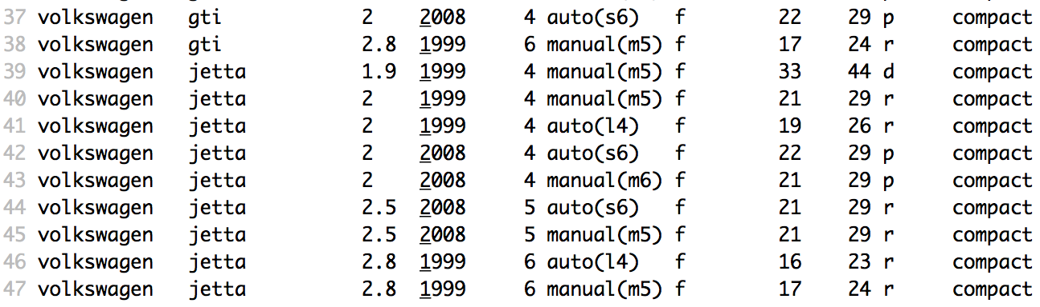
Filter
mpg[mpg$class == "compact",] = mpg %>% filter(class == "compact")

Slide 7
Filtering | More Readable Code
mpg[mpg$class == "compact",] %>% ggplot(aes(x = cty)) + geom_histogram() + ggtitle("City MPG")
mpg %>% filter(class == “compact”) %>% ggplot(aes(x = cty)) + geom_histogram() + ggtitle("City MPG")

Slide 8
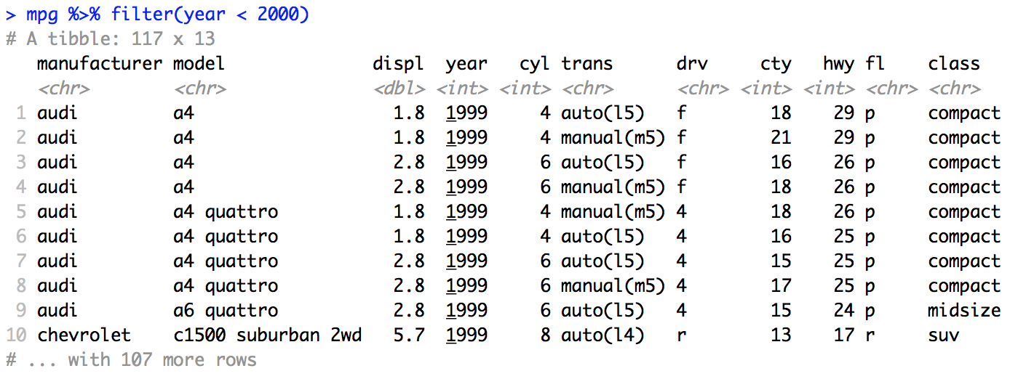
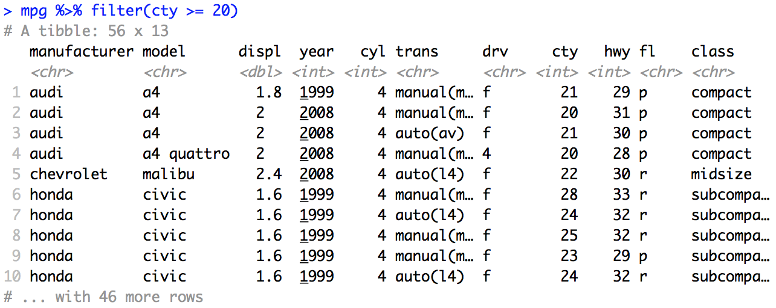
Filtering: >, >=, <, <=, !=
Assume we would like to keep all the cars manufactured before the year 2000.
mpg %>% filter(year < 2000)
Or assume we would like to keep all the cars that have city mpg greater than or equal to 20 mpg.
mpg %>% filter(cty >= 20)

Slide 9
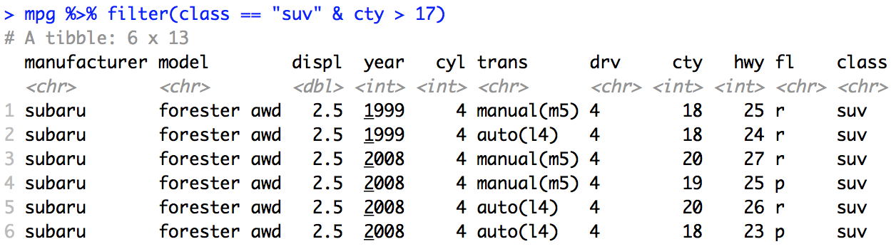
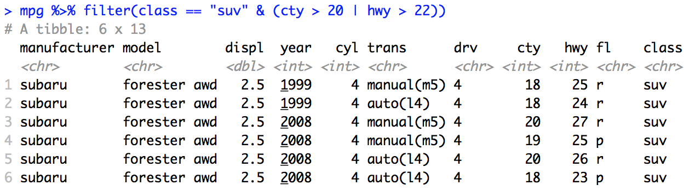
Filtering: &, |, !
Assume we would like to keep all the suvs with city mpg greater than 17 mpg.
mpg %>% filter(class == "suv" & cty > 17)
Or assume we would like to keep all the suvs with city mpg greater than 13 or highway mpg > 10.
mpg %>% filter(class == "suv" & (cty > 13 | hwy > 10))

Slide 11
Missing Values/NA | is.na()

Slide 12
Missing Values
Missing/unknown values in R are recorded as “NA”.
Almost every operation involving an “NA” will produce an “NA”
Example: 4 + NA = NA
Example: NA > 9 = NA
Example: NA / 9 = NA
To determine if a value is NA use: is.na()
Example:
x = NA
is.na(x)
#Answer “[1] TRUE”

Slide 13
Missing Values
Another example:
#Dataframe for the Example
age = c(22,21,NA,24,19,20,23)
yrs_math_ed = c(4,5,NA,2,5,3,5)
names = c("Mary","Martha","Rosy","Kim","Kristen","Amy","Sam")
subject = c("English","Math",NA,"Sociology","Math","Music","Dance")
df = data.frame(Age = age, Years = yrs_math_ed,Name = names, Major = subject)
Df
is.na(df$yrs)
is.na(df$names)
df %>% filter(!is.na(Years)) #Filter out rows with missing Years

Slide 15
Arranging (Sorting) | arrange()

Slide 16
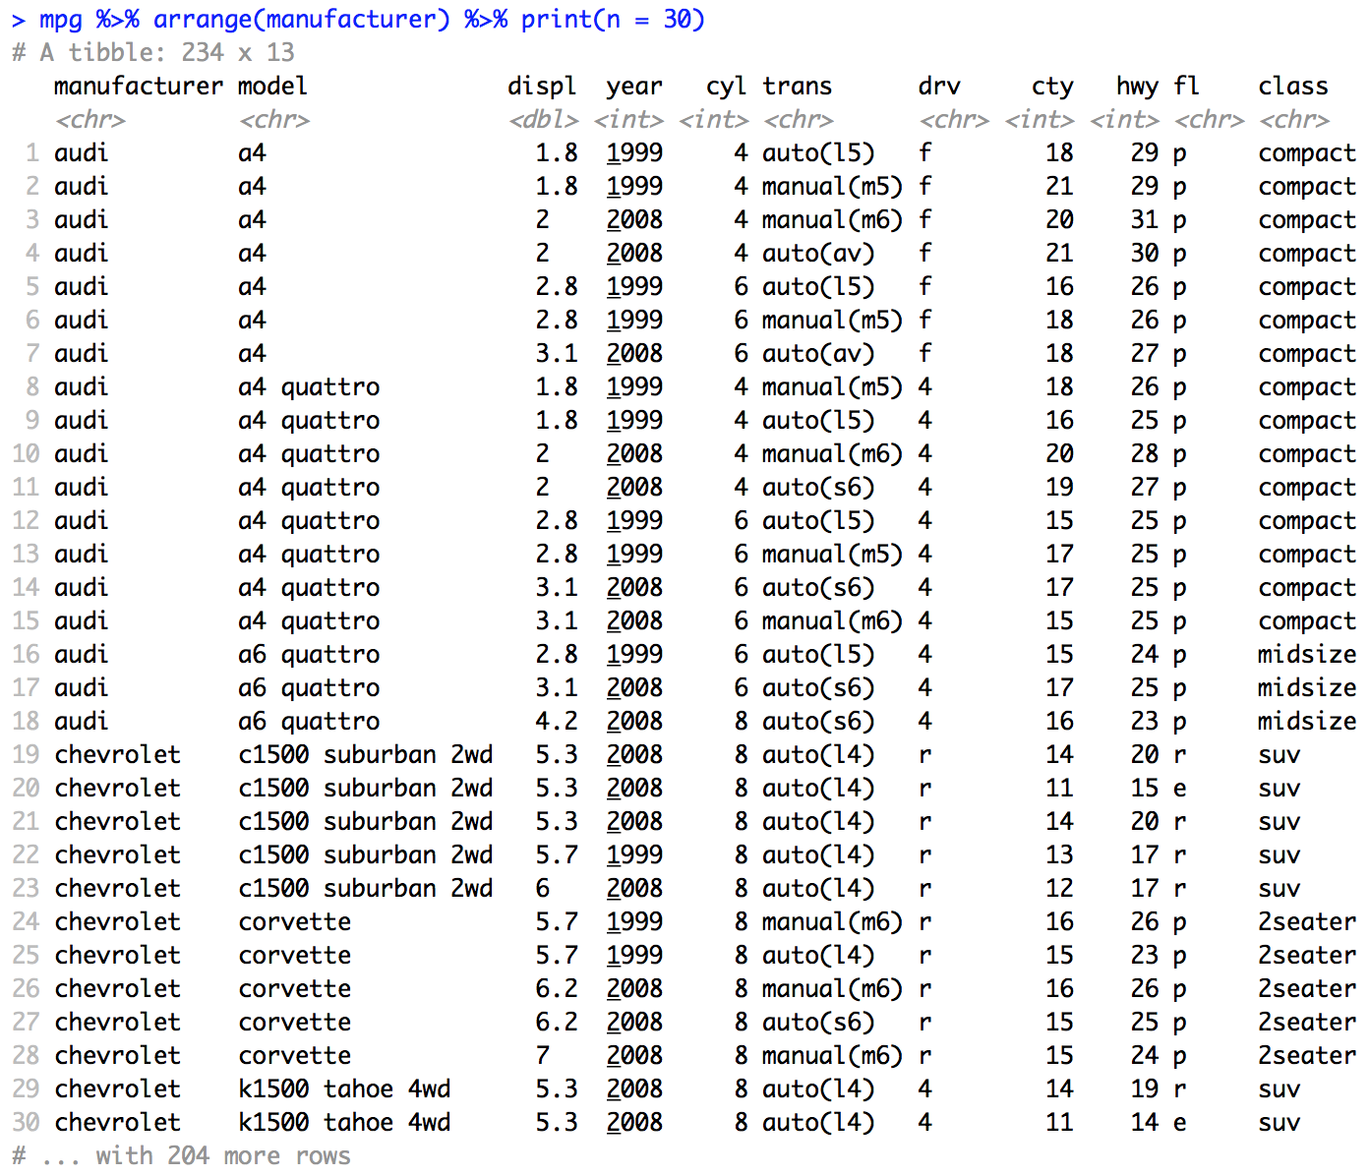
arrange() | One Variable
Arrange is a verb that is synonymous with “sort”.
Example
mpg %>%
arrange(manufacturer) %>%
print(n = 30)

Slide 17
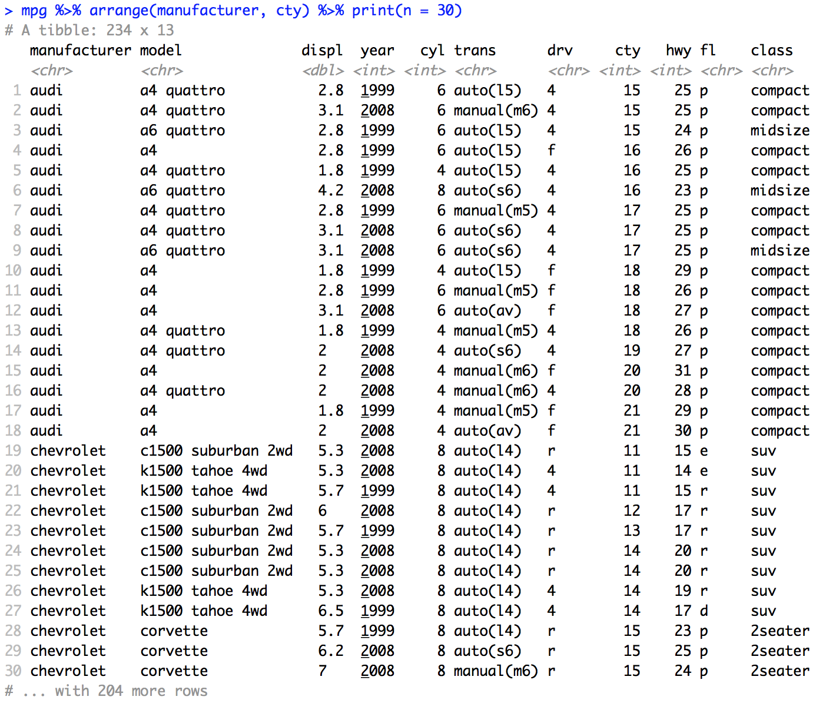
arrange() | Two Variables
Another example
mpg %>%
arrange(manufacturer, cty) %>%
print(n = 30)

Slide 18
arrange() | With Missing Values
Yet another example
#Dataframe for the Example
age = c(22,21,NA,24,19,20,23)
yrs_math_ed = c(4,5,NA,2,5,3,5)
names = c("Mary","Martha","Rosy","Kim","Kristen","Amy","Sam")
subject = c("English","Math",NA,"Sociology","Math","Music","Dance")
df = data.frame(Age = age, Years = yrs_math_ed,Name = names, Major = subject)
df
#Sort on a column with no NAs
df %>% arrange(df3$Name)
#Sort on a column with NAs
df %>% arrange(df3$Age)
# NA end up at the end of the list when sorted on column with NAs.

Slide 20
Selecting Columns | select()

Slide 21
select() v. filter()
filter() chooses rows
# chooses rows with year < 2000
mpg %>% filter(year < 2000)
select() chooses columns
Example suppose you wanted to create a dataset that only had the variables you were interested in. Say your analysis only focused on the relationship between the city and highway miles per gallon variables conditional on the class of the car.
#chooses the columns class, city, hwy
mpg %>% select(class, cty, hwy)

Slide 22
select() and plotting
Example: Suppose you wanted to create a dataset that only had the variables you were interested in. Say your analysis only focused on the relationship between the city and highway miles per gallon variables conditional on the class of the car.
#NEW PACKAGE! Ggally
install.packages("GGally")
library(GGally)
#chooses the columns class, city, hwy
mpg %>%
select(class, cty, hwy) %>%
ggpairs(aes(color = class)

Slide 23

FIFA Dataset
Introducing the football/soccer FIFA player dataset: FifaPlayers.csv.
18,207 players
89 features/attributes
https://www.guidetofootball.com/tactics/playing-positions

Slide 24
FIFA Dataset
Your goal is to analyze the relationships between the player’s rating of his ability to score (Finishing), and his ball control rating (BallControl) and his shot power rating (ShotPower).
fifa %>% select(Finishing, BallControl, ShotPower) %>% ggpairs()

Slide 25
FIFA Dataset
Now your goal is to analyze the relationships between the player’s rating of his ability to score (Finishing), and his ball control rating (BallControl) and his shot power rating (ShotPower) conditional on the athlete’s preferred foot (Preferred.Foot).
fifa %>%
filter(Preferred.Foot == "Right" | Preferred.Foot == "Left") %>%
select(Finishing, BallControl, ShotPower, Preferred.Foot) %>% ggpairs(aes(color = Preferred.Foot))

Slide 26
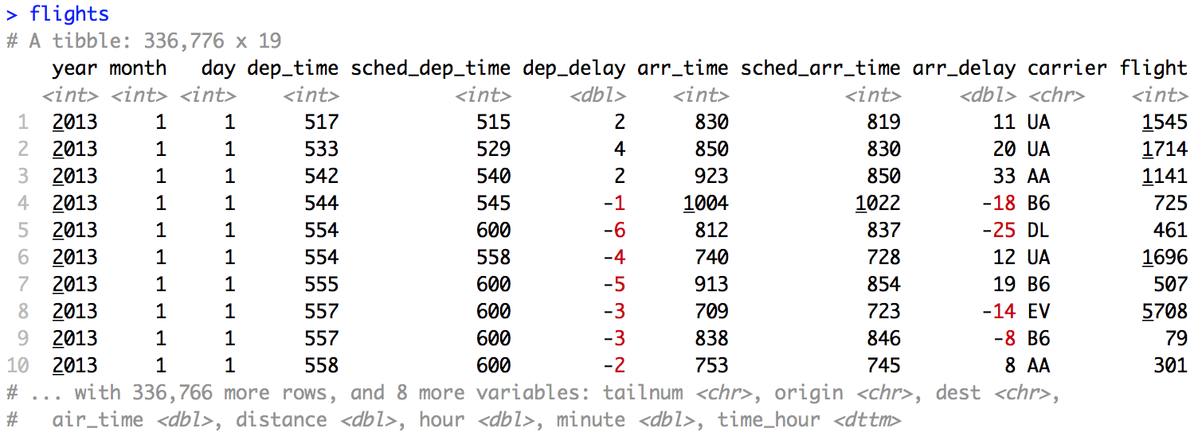
nycflight13
install.packages("nycflights13")
336,776 flights that departed from NYC in 2013
From US Bureau of Transportation Statistics http://bit.ly/trans/stats
?flights

Slide 28
Feature Creation | mutate()

Slide 29
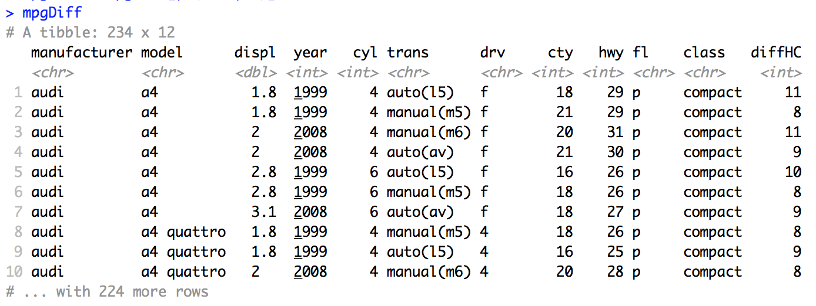
mutate()
Create new variables with mutate().
Assume we would like to look at the relationship between the difference in highway and city mpg and the displacement.
mpgDiff = mpg %>% mutate(diffHC = hwy - cty)

Slide 30
mutate()
Create new variables with mutate().
Assume we would like to look at the relationship between the difference in highway and city mpg and the displacement.
mpg %>%
mutate(diffHC = hwy - cty) %>%
ggplot(aes(x = displ, y = diffHC)) +
geom_point()

Slide 31
mutate()
Create new variables with mutate().
Assume we would like to look at the relationship between the difference in highway and city mpg and the displacement.
mpg %>%
mutate(diffHC = hwy - cty) %>%
ggplot(aes(x = displ, y = diffHC, color = class)) +
geom_point()

Slide 32
mutate()
Create new variables with mutate().
Assume we would like to look at the relationship between the difference in highway and city mpg and the displacement.
mpg %>%
mutate(diffHC = hwy - cty) %>%
ggplot(aes(x = displ, y = diffHC, color = make)) +
geom_point()

Slide 34
Feature Creation | group_by()

Slide 35
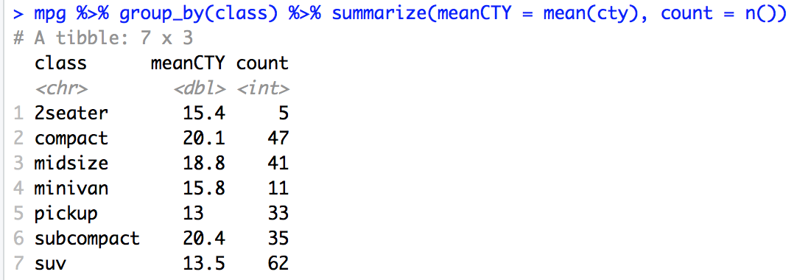
group_by()
We would now simply like a summary chart of the mean city mpg for each of the class groups. We would also like to know how many observations went into each mean.
mpg %>% group_by(class) %>% summarize(meanCTY = mean(cty), count = n())

Slide 36
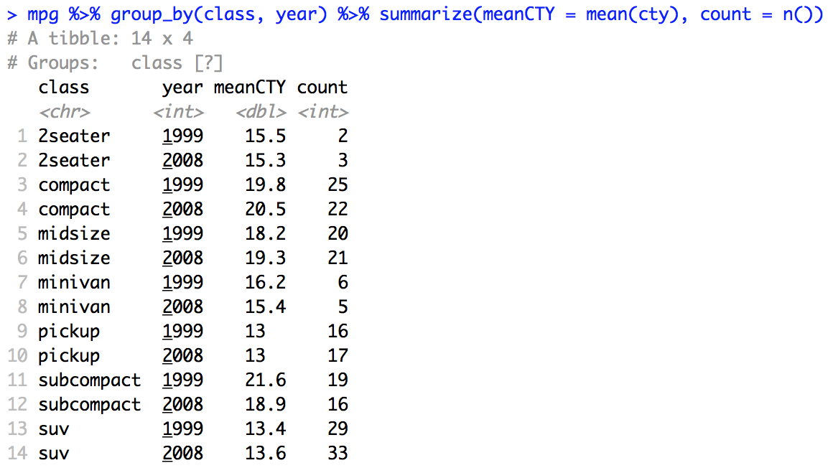
group_by() with Two Variables
We would now simply like a summary chart of the mean city mpg for each of the class groups. We would also like to know how many observations went into each mean.
mpg %>% group_by(class, year) %>% summarize(meanCTY = mean(cty), count = n())

Slide 37
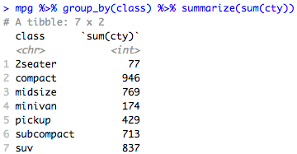
mpg city example from Statistical Transformation in Chapter 2
mpg %>%
group_by(class) %>%
summarize(sum(cty))
#stat = identity adds the values of the y value per class (x level)
mpg %>%
ggplot(aes(x = class, y = cty)) +
geom_bar(stat = "identity")

Slide 38
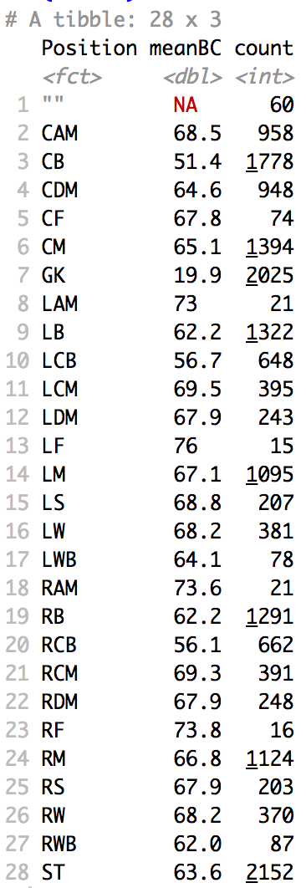
Example: FIFA
It is thought that the midfield is a more skilled position than a fullback. In order to begin to test this you decide to create a chart to compare the mean ball control rating between all the positions.
fifa %>%
group_by(Position) %>%
summarize(meanBC = mean(BallControl), count = n()) %>%
print(n = 28)

Slide 39
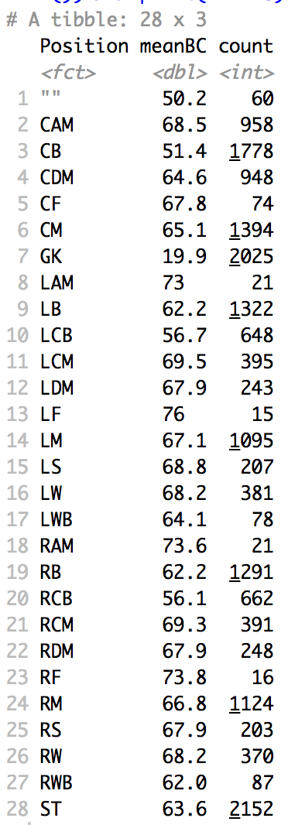
Example: FIFA
It is thought that the midfield is a more skilled position than a fullback. In order to begin to test this you decide to create a chart to compare the mean ball control rating between all the positions.
fifa %>%
group_by(Position) %>%
summarize(meanBC = mean(BallControl,na.rm = TRUE), count = n()) %>%
print(n = 28)

Slide 40
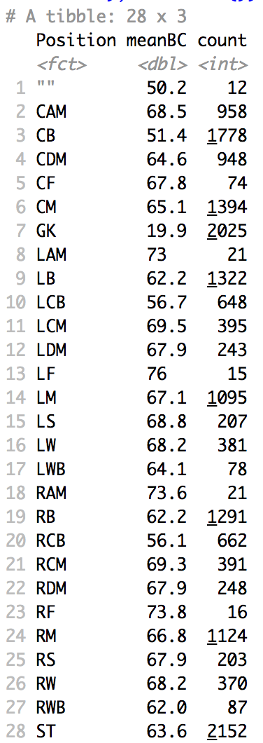
Example: FIFA
It is thought that the midfield is a more skilled position than a fullback. In order to begin to test this you decide to create a chart to compare the mean ball control rating between all the positions.
fifa %>%
filter(!is.na(BallControl)) %>%
group_by(Position) %>%
summarize(meanBC = mean(BallControl), count = n()) %>%
print(n = 28)

Slide 41
Example: FIFA
It is thought that the midfield is a more skilled position than a fullback. In order to begin to test this you decide to create a chart to compare the mean ball control rating between all the positions.
fifa %>% filter(!is.na(BallControl)) %>%
group_by(Position) %>%
summarize(meanBC = mean(BallControl), count = n()) %>%
ggplot(aes(x = Position, y = meanBC)) + geom_col()

Slide 42
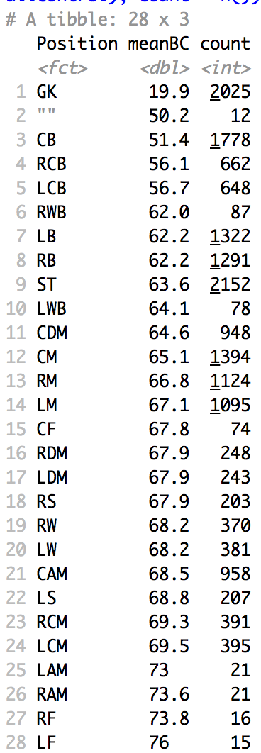
Example: FIFA
It is thought that the midfield is a more skilled position than a fullback. In order to begin to test this you decide to create a chart to compare the mean ball control rating between all the positions.
fifa %>% filter(!is.na(BallControl)) %>%
group_by(Position) %>%
summarize(meanBC = mean(BallControl), count = n()) %>%
arrange(meanBC) %>%
print(n=28)

Slide 44
Factors | factor() and cut()

Slide 45
Factors
A “factor” in R is a categorical variable that takes on a limited number of values known as levels.
Example: Color: Red, Blue, Green
Example: Drive: 4, F, R
We have used them before when we were plotting.
We will use them extensively in modeling.

Slide 46
Factors
Another example:
#Dataframe for the Example
age = c(22,21,NA,24,19,20,23)
yrs_math_ed = c(4,5,NA,2,5,3,5)
names = c("Mary","Martha","Rosy","Kim","Kristen","Amy","Sam")
subject = c("English","Math",NA,"Sociology","Math","Music","Dance")
df = data.frame(Age = age, Years = yrs_math_ed,Name = names, Major = subject)
df
str(df)
# Names and Subjects are already factors.

Slide 47
Factors
Another example:
mpg %>%
ggplot(aes(x = hwy, y = cty, color = cyl)) +
geom_point()
mpg %>%
ggplot(aes(x = hwy, y = cty, color = as.factor(cyl))) +
geom_point()
cylFact = factor(mpg$cyl)
cylFact
levels(cylFact) = c("Four","Five","Six","Eight")
cylFact
cylFact = factor(mpg$cyl, labels = c("Four","Five","Six","Eight"))
cylFact
mpg %>%
mutate(cyl_Factor = cylFact) %>%
ggplot(aes(x = hwy, y = cty, color = cyl_Factor)) +
geom_point()

Slide 48
Factors
#Bar Chart to visualize ball control by position in order of meanBC
#arrange (order) by meanBC
fifa_BC = fifa %>% filter(!is.na(BallControl)) %>% group_by(Position) %>% summarize(meanBC = mean(BallControl), count = n()) %>% arrange(meanBC) %>% print(n=28)
#reorder level of Postition factor
fifa_BC$Position = factor(fifa_BC$Position, level = fifa_BC$Position[order(fifa_BC$meanBC)])
# column plot of ordered results
fifa_BC %>% ggplot(aes(x = Position, y = meanBC)) + geom_col()

Slide 49
Factors | cut()
What if you have a continuous variable that you would like to turn into a factor?
For instance you have a variable in the mpg dataset that measures the displacement (displ). Let’s say we would like to recognize levels of displacement:
High: (6–8)
Medium: (4–6)
Low: (1–4)
displ_Factor = cut(mpg$displ, breaks = c(1,4,6,8), labels = c("Low","Medium","High"))

Slide 50
Factor | cut()
displ_Factor = cut(mpg$displ, breaks = c(1,4,6,8), labels = c("Low","Medium","High"))
mpg %>%
mutate(displ_Factor = displ_Factor) %>%
ggplot(aes(x = hwy, y = cty, color = displ_Factor)) +
geom_point() +
ggtitle("City MPG v. Highway MPG by Displacement")

Slide 52
Exploratory Data Analysis (EDA)

Slide 53
What Is EDA
Exploratory data analysis is an attitude, a state of flexibility, a willingness to look for those things that we believe are not there, as well as those we believe to be there.
—John Tukey
Plots and graphs
Histograms
Box plots
Density plots
Pairwise scatter plots/correlation
Time series plots
Summary statistics
Mean
Five number summary

Slide 54
Why Do EDA?
Long before worrying about how to convince others, you first have to understand what’s happening yourself.
—Andrew Gelman
EDA is not a formal process with a strict set of rules. More than anything, EDA is a state of mind. During the initial phases of EDA you should feel free to investigate every idea that occurs to you. Some of these ideas will pan out, and some will be dead ends. As your exploration continues, you will hone in on a few particularly productive areas that you’ll eventually write up and communicate to others.
—Hadley Wickam

Slide 55
Why Do EDA
Gain intuition about the data
Comparisons between distributions
Sanity check (format, scale)
Missing data
Outliers
Summarize the data

Slide 56
How to Do EDA
EDA is fundamentally a creative process.
—Hadley Wickam
Ask questions about your data.
These questions will lead to new, more fruitful questions.
Use the aforementioned plots, graphs, summary statistics to answer those questions.
Two main types of questions drive EDA
What type of distribution do my variables follow?
What type of covariation occurs between my variables?

Slide 58
EDA | Visualizing Distributions

Slide 59
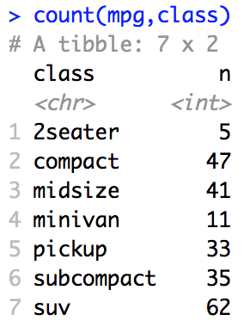
Categorical Variables
mpg %>% ggplot(aes(x = class, fill = class)) + geom_bar()
totals = count(mpg,class)
mpg %>% ggplot(aes(x = class, fill = class)) + geom_bar() + geom_text(aes(class, totals$n + 2, label = totals$n, fill = NULL), data = totals)

Slide 60
Continuous Variables
mpg %>% ggplot(aes(x = cty, fill = class)) + geom_histogram()
mpg %>% ggplot(aes(x = cty, color = class)) + geom_freqpoly ()

Slide 61
Continuous Variables
mpg %>% ggplot(aes(y = cty, color = class)) + geom_boxplot()

Slide 62
Continuous Variables
mpg %>% ggplot(aes(x = cty, color = class)) + geom_histogram() + facet_grid(rows = vars(class))

Slide 63
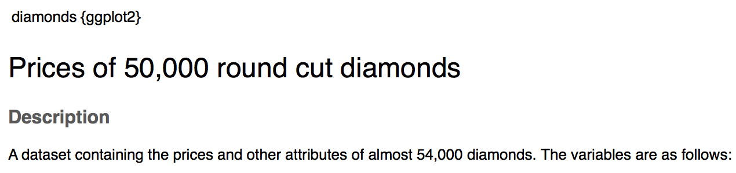
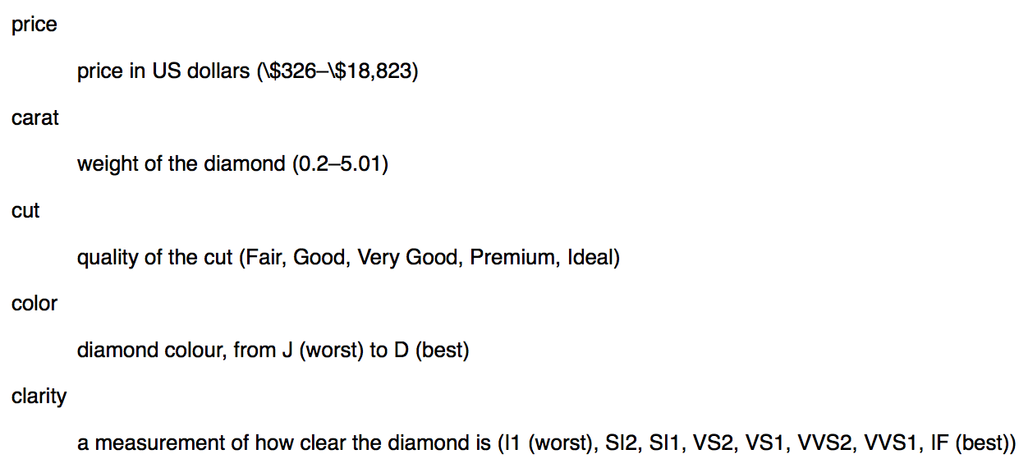
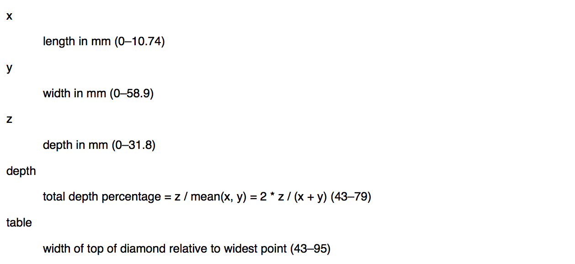
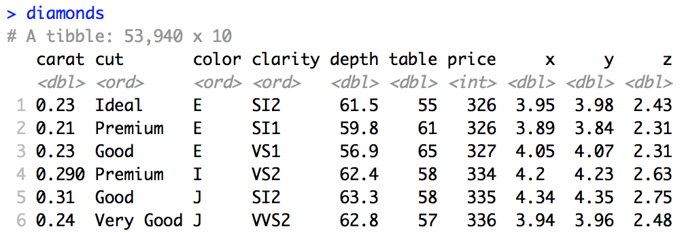
Diamonds

Slide 65
EDA | Two Fundamental Parameters
Center and Spread

Slide 66
Center and Spread
Nearly every distribution has two fundamental parameters
Center
Mean
Median
Mode
Spread
Variance/standard deviation
Range
Interquartile Range (IQR)

Slide 67
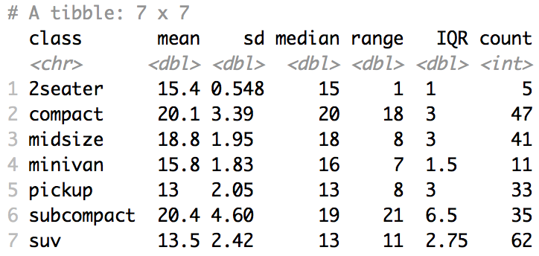
Center and Spread
mpg %>% group_by(class) %>% summarize(mean = mean(cty), sd = sd(cty), median = median(cty), range = max(cty)-min(cty), IQR = IQR(cty), count = n())

Slide 69
EDA | Missing Values

Slide 70
Missing Values / NA = Not Available
Identify missing values (“NA”)
Numerical
Categorical
Mark known errors as NA.
Numerical
Categorical

Slide 71
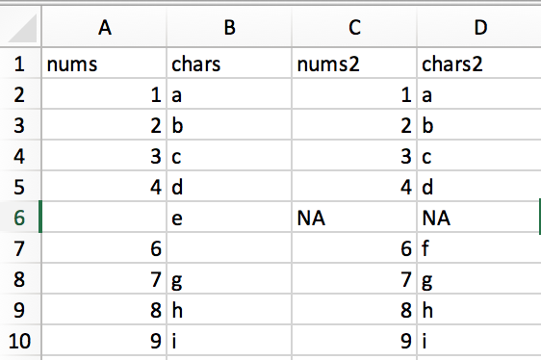
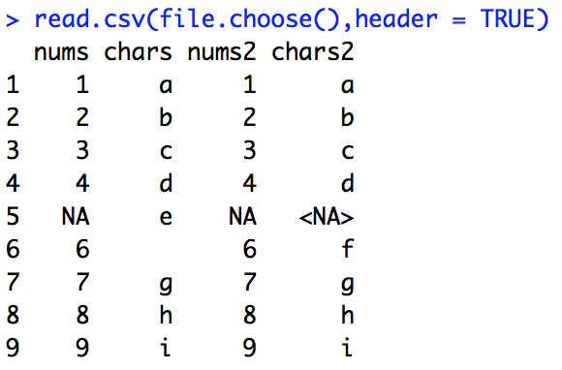
Missing Value | “” v. NA. v. <NA>

Slide 72
Missing Value | “” v. NA. v. <NA>
# Bring in MissingValueToy.csv as ’a’
a = read.csv(file.choose(),header = TRUE)
# count missing values in each column
s = sapply(a, function(x) sum(is.na(x)))
# Make all missing values NA
a$chars = ifelse(a$chars == "",NA,a$chars)
a$chars2 = ifelse(a$chars2 == "<NA>",NA,a$chars2)
library(naniar)
gg_miss_var(a)

Slide 73
Missing Values | identify | FIFA
library(naniar) gg_miss_var(fifa[,1:40]) + ylim(0,75)
gg_miss_var(fifa[,41:89]) + ylim(0,75)
sapply(fifa, function(x) sum(is.na(x)))

Slide 74
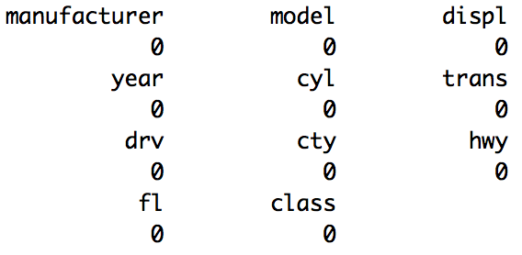
Missing Values | identify | mpg
library(naniar) gg_miss_var(mpg) + ylim(0,10)
sapply(mpg, function(x) sum(is.na(x)))

Slide 75
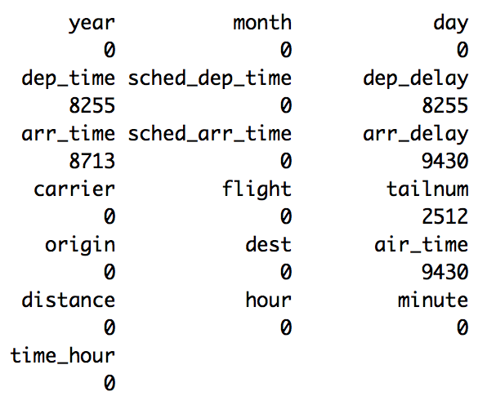
Missing Values | identify | flights
library(naniar)
library(nycflights13)
gg_miss_var(flights)
sapply(flights, function(x) sum(is.na(x)))

Slide 77
Outliers and Unusual Values

Slide 78
Outliers and Unusual Values
Reasons
Errors
Recording error (typo)
Measurement error
Extreme Values
Treatment
Do not automatically delete outliers.
Run the analysis with and without outliers.
If not significantly different, leave them in.
If significantly different, investigate the outliers further

Slide 79
mpg: Outliers and Unusual Values
#Find unusual city mpg values
library(ploltly)
p = mpg %>%
ggplot(aes(x = cty)) + geom_histogram()
ggplotly(p)
#Find unusual city mpg values
library(ploltly)
p = mpg %>%
ggplot(aes(y = cty)) + geom_boxplot()
ggplotly(p)
Notes:
DO IT BY CLASS AS WELL TO CHECK FOR POSSIBLE ERROR.

Slide 80
Flights: Outliers and Unusual Values
#Find unusual arrival delay values
library(ploltly)
p = flights %>% ggplot(aes(x = arr_delay)) + geom_histogram()
ggplotly(p)
#Find unusual arrival delay values
library(ploltly)
p = flights %>%
ggplot(aes(y = arr_delay)) + geom_boxplot()
ggplotly(p)

Slide 81
Diamonds: Outliers and Unusual Values
#Find unusual carat values
library(ploltly)
p = diamonds %>% ggplot(aes(x = carat)) + geom_histogram()
ggplotly(p)
#Find unusual y values
library(ploltly)
p = diamonds %>% ggplot(aes(x = y) + geom_histogram()
ggplotly(p)
#Check if they are Potentially Errors or just Outliers.
diamonds %>%
mutate(priceFact = cut(price, breaks = c(0,2000,10000,15000, 19000), labels = c("Low","Medium", "High", "Very High"))) %>%
ggplot(aes(x = carat, fill = priceFact)) +
geom_histogram()

Slide 83
EDA | Covariation

Slide 84
Categorical and Continuous
mpg %>%
ggplot(aes(y = cty, color = class)) +
geom_boxplot()

Slide 85
Categorical and Continuous
mpg %>%
ggplot(aes(x = cty, color = class)) +
geom_histogram() +
facet_grid(rows = vars(class))

Slide 86
Categorical and Continuous
diamonds %>%
mutate(priceFact = cut(price, breaks = c(0,2000,10000,15000, 19000), labels = c("Low","Medium", "High", "Very High"))) %>%
ggplot(aes(x = carat, fill = priceFact)) +
geom_histogram() + ylim(c(0,200)) +
facet_wrap(vars(priceFact))

Slide 87
Categorical and Categorical
p = diamonds %>%
count(color,cut) %>%
ggplot(aes(x = color, y = cut)) +
geom_tile(mapping = aes(fill = n))
ggplotly(p)

Slide 88
Categorical and Categorical
p = fifa %>%
filter(!is.na(BallControl)) %>%
mutate(BallControlFact = cut(BallControl, breaks = c(0,30,60,90,100), labels = c("Very Low", "Low", "Medium", "High"))) %>%
count(Position, BallControlFact) %>%
ggplot(aes(x = Position, BallControlFact)) + geom_tile(mapping = aes(fill = n))
ggplotly(p)

Slide 89
Continuous and Continuous
mpg %>% ggplot(aes(x = hwy, y = cty)) +
geom_point(color = "blue")
#note that color is not in an ”aes”
# function we are setting them manually.

Slide 90
Continuous and Continuous
flights %>%
ggplot(aes(x = dep_delay, y = arr_delay)) +
geom_boxplot(mapping = aes(group = cut_width(dep_delay,50)))+
xlim(c(0,700))

Slide 91
Continuous, Continuous, and Categorical
mpg %>% ggplot(aes(x = displ, y = cty)) +
geom_point(color = class)

Slide 92
All at Once
mpg %>%
select(displ, hwy, class) %>%
ggpairs(aes(color = class))

Slide 94
Example | Diamonds

Slide 95
EDA | A Review
Remember, EDA is a creative process that is driven by your questions.
It is not a formal process.
You should investigate every idea that occurs to you.
Each data scientist’s specific EDA on a given dataset is likely to be different.

Slide 96
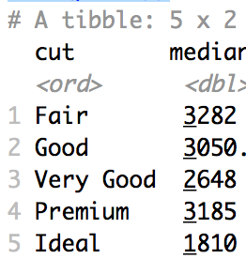
EDA | Diamonds
Let’s start by plotting the data… this is always a good (and recommended) place to start.
diamonds %>%
select(price, carat, cut) %>%
ggpairs(mapping = aes(color = cut))
Question 1 arises instantly!:
Fair looks to have the highest median price and ideal looks to have the lowest! Why?
diamonds %>%
group_by(cut) %>%
summarize(median = median(price))

Slide 97
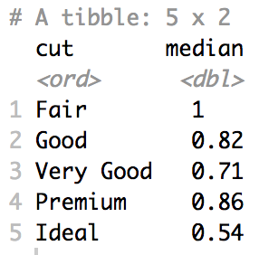
EDA | Diamonds
Question 2: (Posed in an effort to answer question 1.)
What is the relationship between cut and carat?
Judging from the boxplots and the histograms, it looks like the ideal diamonds have the smallest median carat. Let’s verify:

Slide 98
EDA | Diamonds
Question 3: (Posed in an effort to answer question 1.)
What is the relationship between price and carat?
Judging from the scatterplot of price v. carat, there looks to be a positive relationship between the two. Let’s replot to put carat on the x axis and price on the y axis.
diamonds %>%
ggplot(aes(x = carat, y = price)) +
geom_point()

Slide 99
EDA | Diamonds
Question 3: (Posed in an effort to answer question 1.)
What is the relationship between price and carat?
There certainly looks like overwhelming evidence of a positive relationship. We also discovered an odd pattern in the data… this may spawn a new question and new insight. We will stick with our original question for now.

Slide 100
EDA | Diamonds
Question 4: (Posed in an effort to answer question 1.)
If we account for the carat, will we see what we expect with respect to the cut and price?
It is a little evident here as the yellow (ideal) tends to the top of the plot (higher price) and the purple (fair) tends to the bottom of the plot.
We can use regression to actually take out the effect of the carat on the price so we can directly look at cut versus price (after accounting for carat) …

Slide 101
EDA | Diamonds
Question 4: (Posed in an effort to answer question 1.)
If we account for the carat, will we see what we expect with respect to the cut and price?
We take the log—log transformation in order to fulfil the assumption of the simple linear regression model (linear relationship between price and carat with equal standard deviation of log(price) conditional on log(carat).
diamonds %>%
mutate(lcarat = log(carat), lprice = log(price)) %>%
ggplot(aes(x = lcarat, y = lprice)) +
geom_point()
There is an interesting band at log price = 7.4 or so… that would spawn a new question for me… but again … we will stay on question 1 … but we would come back to this question as part of the EDA…

Slide 102

EDA | Diamonds
Question 4: (Posed in an effort to answer question 1.)
If we account for the carat, will we see what we expect with respect to the cut and price?
Now we fit the model:
$$log\left(price\right)= β_{0}+β_{1}log\left(carat\right)+ε$$
diamonds %>%
mutate(lcarat = log(carat), lprice = log(price)) %>%
ggplot(aes(x = lcarat, y = lprice)) +
geom_point() +
geom_smooth(method = "lm") +
ylim(c(5.5, 10))
residual = observed – expected …
residual = actual log price (black dot) – predicted price (point on blue line).
The residuals contain information about price with the effect of carat removed.

Slide 103
EDA | Diamonds
Question 4: (Posed in an effort to answer question 1.)
If we account for the carat, will we see what we expect with respect to the cut and price?
Now we fit the model:
$$log\left(price\right)= β_{0}+β_{1}log\left(carat\right)+ε$$
diamonds %>%
mutate(resids = exp(fit$residuals)) %>%
ggplot(aes(x = carat, y = resids)) +
geom_point()
residual = observed – expected …
residual = price of each black dot – corresponding point on blue line.
The residuals contain information the other variables have about price with the effect of carat removed.

Slide 104
EDA | Diamonds
Question 4: (Posed in an effort to answer question 1.)
If we account for the carat, will we see what we expect with respect to the cut and price?
Now we fit the model:
$$log\left(price\right)= β_{0}+β_{1}log\left(carat\right)+ε$$
diamonds %>%
mutate(resids = exp(fit$residuals)) %>%
ggplot(aes(x = carat, y = resids, color = cut)) +
geom_point()
It still looks like the yellow tend to the top and the purple tend to the bottom (with some notable exceptions that will be further EDA opportunities!)
But lets get clearer visual evidence.

Slide 105
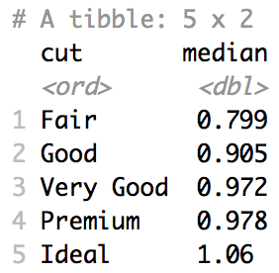
EDA | Diamonds
Question 4: (Posed in an effort to answer question 1.)
If we account for the carat, will we see what we expect with respect to the cut and price?
diamonds %>%
mutate(resids = exp(fit$residuals)) %>%
ggplot(aes(y = resids, color = cut)) +
geom_boxplot()
diamonds %>%
mutate(resids = exp(fit$residuals)) %>%
group_by(cut) %>%
summarise(median = median(resids))
We now have strong visual evidence that the price of the diamonds, after accounting for carat, is greater for the ideal cut diamonds than the fair cut diamonds.

